Slide 1

Sentiment Analyser: Sentiment Analysis from text Analysis

Slide 2
Statement of Problem
For years now, Artificial Intelligence and Machine Learning has been an area of great interest among Computer Science Enthusiasts and this project focuses on one of at the very important components of ML which is Natural Language Processing (NLP). The Human Language is a very complex and sophisticated form of communication and making a computer understand this is a very difficult task especially when using traditional methods of programming and data structures. Hence, a novel approach to tackle the problem has been suggested.

Slide 3
Idea Description
We have built a command line application using open source Python language to extract meaning and insight from textual content.
This project focuses on solving three problems of the modern society namely, 1. Cyber Bullying 2. Brand/Product Analysis 3. Categorize opinions expressed in feedback forums.

Slide 4
Technology Stack and Dependencies
Python
Libraries
API
Numpy
Scipy
Aylien API Client
Matplotlib
Tweepy
Pandas
TDA

Slide 5
Technology Stack and Dependencies
Python (https://www.python.org/)
Aylien-API (https://aylien.com/)
Numpy (https://numpy.org/)
Scipy (https://www.scipy.org/)
Matplotlib (https://matplotlib.org/)
Pandas (https://pandas.pydata.org/)
Tweepy (https://www.tweepy.org/)
Twitter Developmenmt API (https://developer.twitter.com/)

Slide 6
Working
The first part of the project is a sentiment analyser. Built on the Aylien API using Python, the project uses Machine Learning to provide a polarity for a given query which is of three types - Positive, Negative and Neutral.
If the polarity of a query is negative, it is deemed unsuitable and struck out.
https://github.com/rajdas2001/Sentiment-Analyser

Slide 7
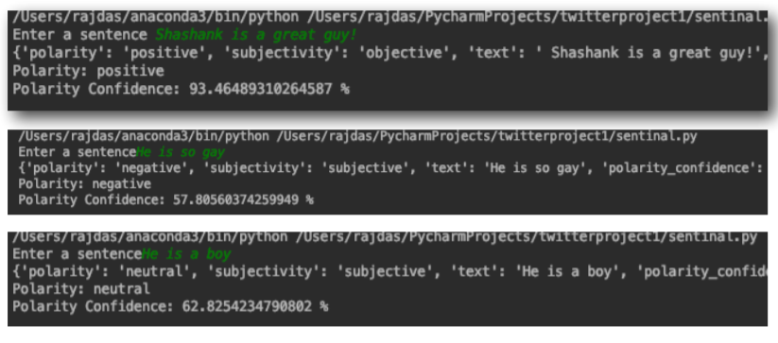
Graphical Interface

Slide 8
Images

Slide 9
Working
The second part of the project is for Brand/Product Analysis and is based on the previously discussed model. Here, instead of taking queries from the user, it takes data from social media platforms like Twitter, analyses them, creates CSV file and then provides a pie chart of the sentiments for the same.

Slide 10
Our process is easy
Collect Data
1
Analyze the data
2
Provide Useful Insights
3

Slide 11
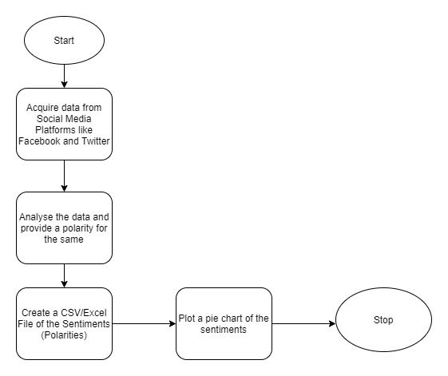
Flow Chart

Slide 12
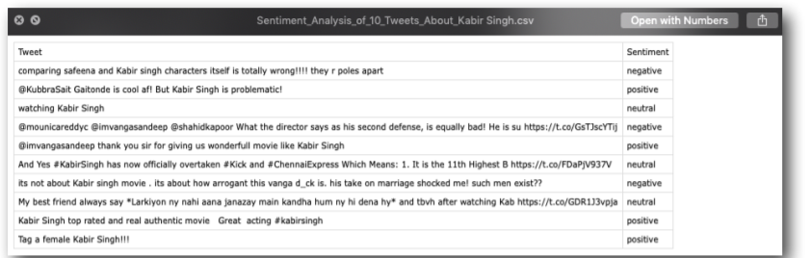
Images

Slide 13
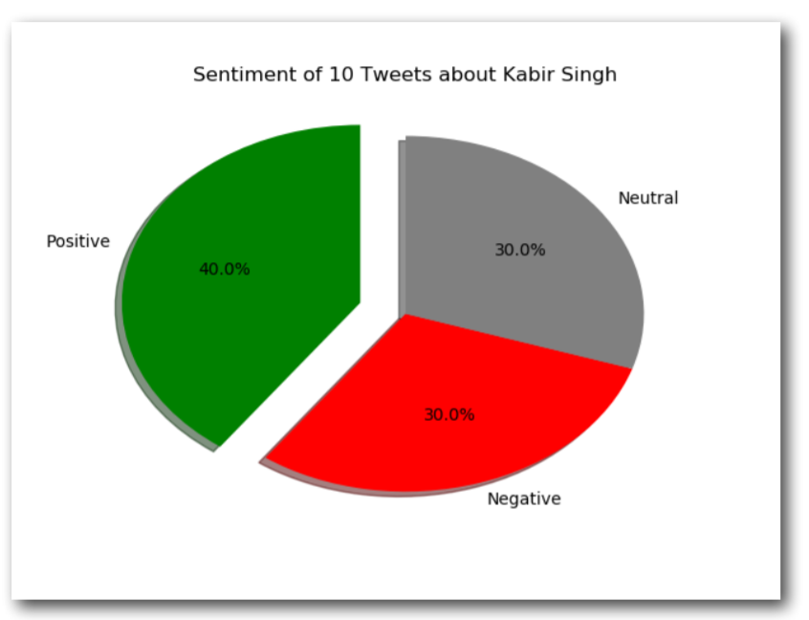
Images

Slide 14
Future Work Plan
Sentiment Analyser
One of the future work-plans for this project is its integration into web browsers. Once the program is integrated via an extension, the program can parse through each line of text on the website, check its polarity and strike out the things that are offensive (polarity=‘negative’).
One more way of ensuring a safe internet is by image analysis. An image on a website is taken in as a query and a polarity is generated which can then be checked for its content. But once again, it’s a part of the future work-plan.
One more workplan that we have is a port for Indian Language.
Brand/ Product Analyser
We are also thinking of creating a GUI based business suite for entrepreneurs for the easy use of the software for brand/product analysis.
Feedback Form Analysis
We are also thinking of creating a GUI based application for analyzing and inferring useful outcomes from the feedback forms.

Slide 15
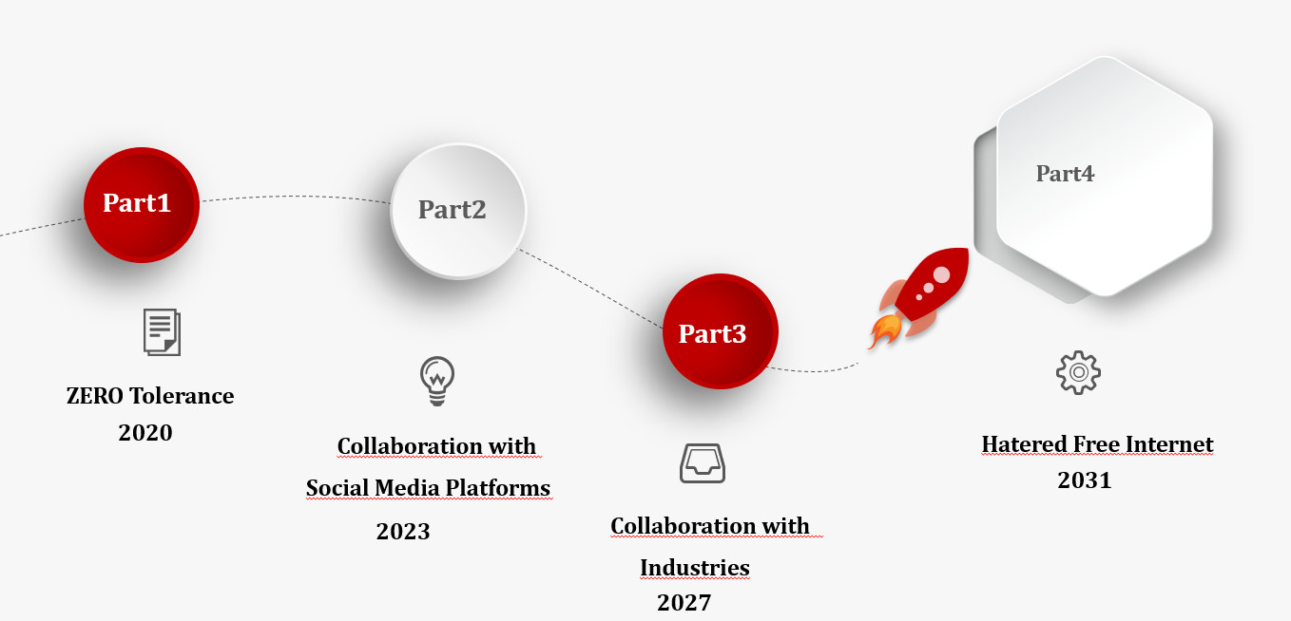
Timeline

Slide 16
Busines Model

Slide 17
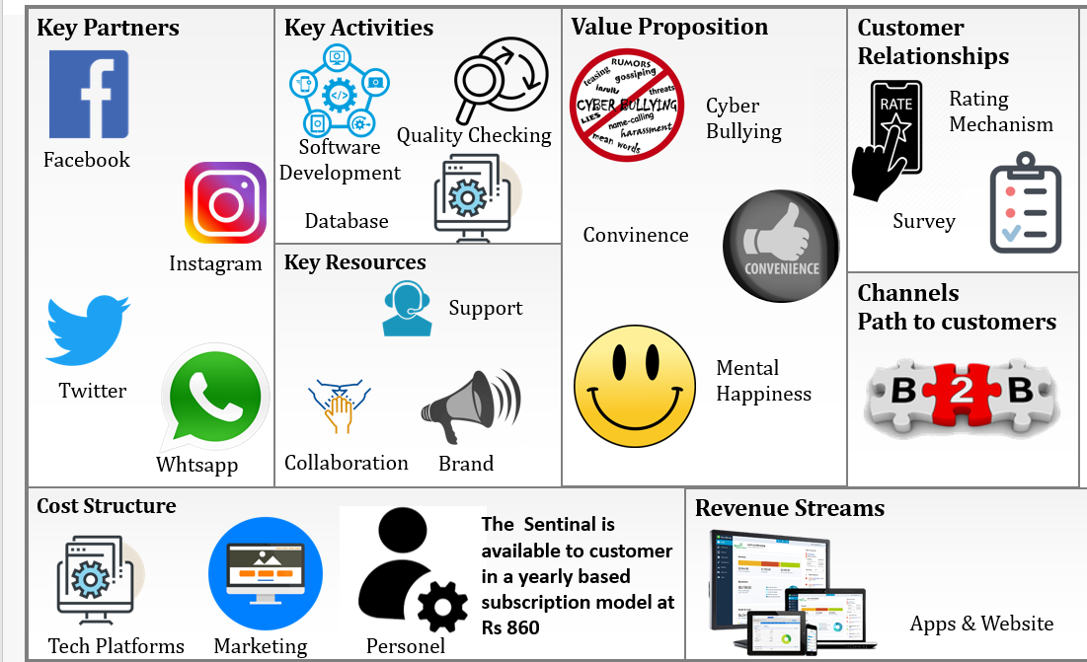
Model Canvas – Business Model

Slide 18
Demo Time!

Slide 19
Any questions?
Thank You!

